Slide 1
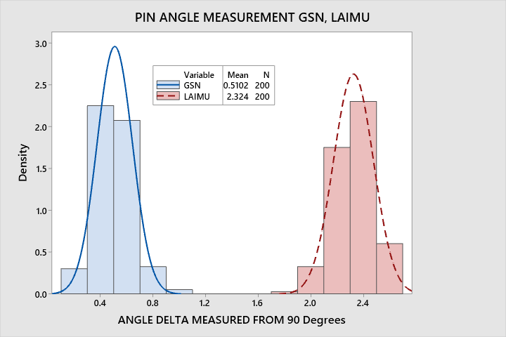
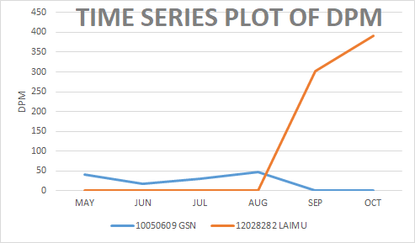
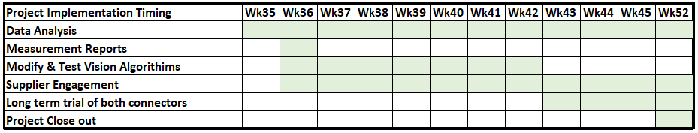
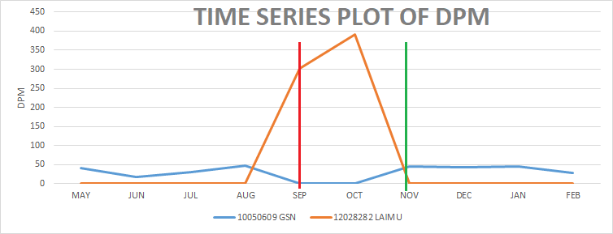
Lean Six Sigma Project Storyboard
Project Name: Misplaced Connectors
Start Date: 09/09/2019
ANALYZE: DRIVERS / ROOT CAUSES / VITAL FEW
Project Leader: Bertie Harte
End Date: 21/02/2020
Analyses of the raw material found that LAIMU parts were typically at the upper end of the tolerance range, while GSN parts were distributed around the mid point, resulting in the potential for tolerance stack errors.
The high drop rate was due to the vision algorithms being unable to adequately locate the pin tips for measurement, due to the change in surface finish.
Project Type: Quality Improvement (DPM reduction)
Industry: Electronics Production
DEFINE: PROBLEM / BASELINE / GOAL
Problem Statement : Scope of the project is to reduce genuine defect rates for through-hole connectors on electronics sub-assemblies. The primary aim is to prevent the connectors from being misplaced using Siplace vision. Historical defect rate was <50 DPM, an ECO change to an alternate (cheaper) component resulted in a sharp increase to >300DPM. Supplier engagement is necessary to improve component defect rates.
Baseline : Baseline was calculated based on 20 weeks data, prior to ECO change in September.
Goal : To return the defect rate to below 50DPM for this connector.
IMPROVE: INNOVATION / IMPLEMENTATION PLANNING
Solution is to modify the vision algorithms to detect single pin position variance, while maintaining the overall reliability of the vision process. Engaging with the supplier to bring the pin positions closes to the center line of the tolerance is also required.
MEASURE: PROCESS / EXPERT KNOWLEDGE / DATA
CONTROL: RESULTS / SUSTAINING
Impact
DPM Reduction from Mean of 346 to Target of <50 was achieved by reverting to GSN.
Reduction in component dropped losses from 18% to 7%
Throughput unaffected.
This is a complex problem as using strict vision algorithms to reject problem components results in high losses in raw material and has a negative impact on throughput, including regular machine stoppages.
Finding a balance between protecting the customer by reducing genuine defect rates, and ensuring that production targets are met, without incurring significant cost increases is also a requirement.
Where material is found to be a major contributor reliable data for the supplier improvement program is necessary. Laimu connectors had poorly formed 90deg bends on pins
Notes:
Try to choose just the one key tool in each phase of your project and link this to the other phases to create a high level story of the project. Don’t try to fit more. Keep the text to a minimum, using bullets rather than sentences. Concentrate on the key issues, root causes, solutions, impacts.

